Slide 1
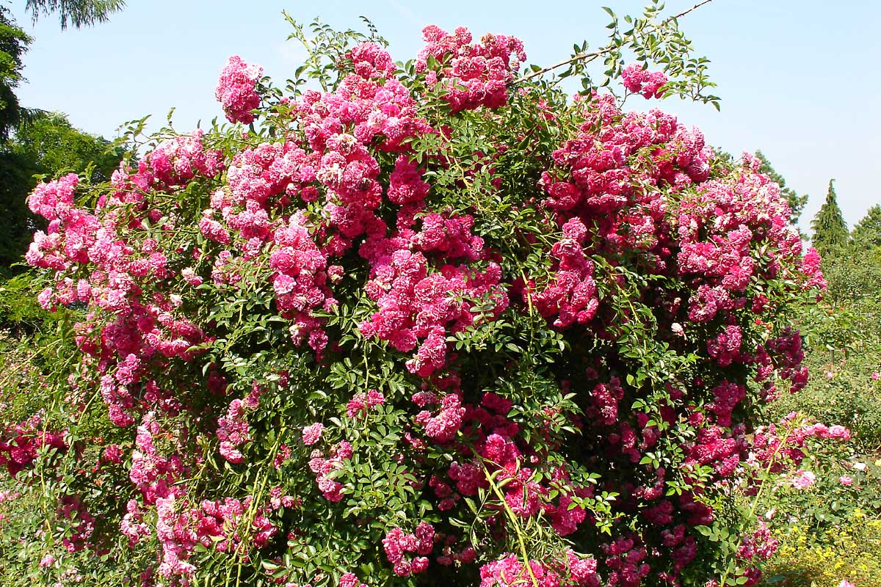
HEAT ENGINE
D.A.Degree Engineering &Technology college
(Mahemdabad)
DEPT. MECHANICAL
PREPARED BY;
Assi. Prof. shyamal prajapati
D.A.DEGREE ENGG. & TECHNOLOGY

Slide 2
HEAT ENGINES
Heat engine:
Heat engines is a device in which net heat is added to the engine and net work transfer from the engine.
Thus for heat engine net heat transfer and net work transfer both are positive in a cycle executed by the engine.
Heat engines can be classified in two catagories
External combustion engines
Internal combustion engines

Slide 3
External combustion engines
In this type of engines combustion of fuel take place outside the engine. Generally heat liberated by combustion of fuel is transferred to working fluid of the engine.
Examples: steam engines, steam turbines, close cycle gas turbines
In steam engines and steam turbines combustion of fuel take place in boiler, which produces high pressure steam. This steam in expanded in steam engines or turbines which produce mechanical work.

Slide 4
Internal combustion engines:(I.C. engines)
In I.C. engines combustion of fuel take place in the engines. Combustion of fuel take place with help of air. Combustion product itself are the working fluid of engines.
Examples: petrol engines, diesel engines, open cycle gas turbines

Slide 5
Difference b/w External com. eng. and Internal com. eng. :-
Internal com. Eng. | External com. Eng.
They are compact in size and hence suitable for small capacity. | They are bulky and hence designed for large capacity.
More refined fuel is required which is costly. Generally used with liquid and gaseous fuel. | Cheaper fuel can be used. Generally solid , liquid and gaseous fuel is used.

Slide 6
Con.
3) Due to less components , complexity is less. | More complex.
Lower efficiency. | 4) Higher efficiency.
More pollutent. | 5) Less pollutent.

Slide 7
Working fluid:
All thermodynamic system require some working substance in order to perform various operations to execute a thermodynamic cycle.
These working substance are known as working fluids.
They can readily be compressed or expanded. They also receive or reject heat.
Common examples of working fluids are air and steam.
Analysis of all heat engine cycles involve calculation of various properties of these working fluids.

Slide 8
Converting machines:
A machine which convert heat energy in to mechanical work is called converting machines.
A converting machine having hollow cylinder in which piston reciprocating due to expansion and compression of working fluid is known as reciprocating machines.
Rotary machines consists of wheel having blader or vanes mounted on a shaft.
Wheel rotates on shaft due to action of working fluid on the blades.
In jet machines working fluid discharges from machine in form of jet and motion is caused due to reaction of jet.

Slide 9
Essential components of heat engines:
A thermodynamic cycle is executed by heat engine to produce net positive work from net positive heat addition to the engine.
This cycle is known as heat engine cycles.
Sometime it also refer as power cycle.
A heat engine cycle consists of series of processes.
Each process requires some device or component for process to take place.
The essential component of heat engine are as follows.

Slide 10
Heat source: It is reservoir of heat from which heat is supplied to working fluid. Examples: Furnace of boiler, combustion chamber of I.C. engines.
Heat sink: according to law certain heat has to rejected by heat engine at lower temperature in order to develop work in a cycle. A heat sink is a low temperature reservoir where heat is rejected by the working fluid.
Working fluid: substance which receive and reject heat and undergoes various processes of heat engine cycle is called working fluid.
Expander or Turbine: It is a device in which working fluid is expanded and work is available.

Slide 11
Carnot cycle:
Carnot conceived an ideal cycle in which all processes are reversible. Carnot cycle is represented on p-V diagram. Processes of carnot cycle are as follow.
Process 1-2: Heat is added to the system (of working fluid) at constant temperature TH from the source. Working substance is expanded reversibly at constant temperature.
Process 2-3: Working fluid undergoes a reversible adiabatic expansion. Temperature will reduce from TH to TL.
Process 3-4:Working fluid rejects heat at constant temperature TL to sink reversibly. Working fluid is said to be comprerssed at constant temperature TL.
Process 4-1:Working fluid undergoes a reversible adiabatic compression and its temperature will increase from TL to TH.

Slide 12
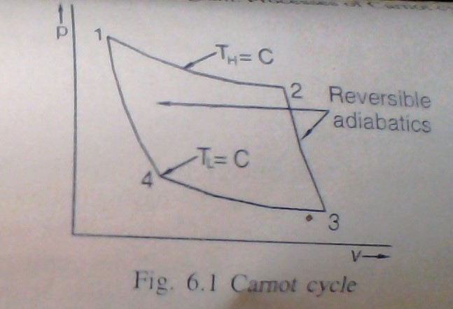
Carnot cycle:

Slide 13
Limitation of carnot cycle:
To have heat addition and heat rejection at constant temperature piston has to move as slowly as possible. While during adiabatic expansion and compression piston has to move as quickly as possible.
In actual practice friction is always present.
Perfectly adiabatic wall is hypothesis.
In actual practice for heat transfer finite temperature difference is always required mean heat transfer is not reversible.

Slide 14
Rankine cycle:
We have seen that it is difficult to pump mixture of vapour and liquid and deliver it as saturated liquid.
This is eliminated in rantine cycle by complete condensation of vapour in condenser and then pumping the water isentropically to the boiler pressure.
Rankine cycle consists of four processes. This processes take place in four components
Boiler
Turbine
Condenser
Feed pump

Slide 15
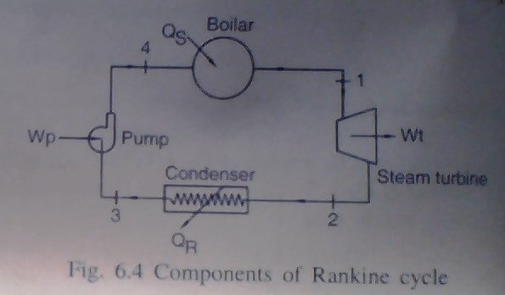
Components of rankine cycle:

Slide 16
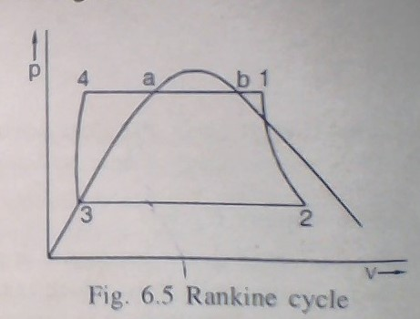
Rankine cycle:

Slide 17
Cont.
Process 1-2: superheated, dry saturated or wet steam or expanded isentropically in to steam turbine from boiler to condenser. In practical cycle state 1 always superheated steam.
Process 2-3:steam is condensed in condenser at constant pressure. It leaves the condenser as saturated liquid. Steam is condensed by transferring heat to cooling water.
Process 3-4:saturated water at condenser is pumped to boiler pressure.
Process 4-1:heat is supplied to water at constant pressure in boiler.

Slide 18
Air standard cycles:
In gas power plants like gas turbine or internal combustion engine working fluid is always in gaseous state.
In most gas power cycles,the working fluid consists mainly of air.
In internal combustion engine air fuel ratio varies from 10:1 to 24:1 depending upon type of engine.
In gas turbine plants this ratio varies from 50:1 to 250:1 .
Hence properties of working fluid is similar to properties of air.
Therefore gas power cycle analysis can be done by idealised cycle known as air standard cycle which uses pure air as working fluid.

Slide 19
Assumptions for air standard cycle:
The working fluid is air and it follows the ideal gas laws and hence follows pV=mRT.
The working fluid is homogeneous throughout at all time and no chemical reaction takes place.
Specific heat or air is constant and do not vary with temperature one may take Cp=1.005 kJ/kg K and Cv=0.718 kJ/kg K.
The mass of air in cycle remains fixed. The cycle is execuated by closed system and there is no suction or exhaust process.
Combustion process is replaced by equivalent heat transfer process (Heat addition to cycle.)
Since exhaust process is not there it is replaced by equivalent heat rejection.
All processes of the cycle are reversible.

Slide 20
Otto cycle (constant volume cycle):
An air standard otto cycle which is also known as constant volume cycle consists of four processes.
Two of then are reversible adiabatic (isentropic) and the other two constant volume processes.
An air standard otto cycle on p-V diagram.

Slide 21
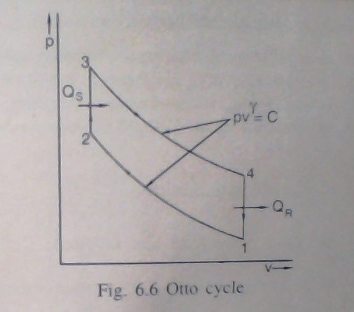
Otto cycle:

Slide 22
Con.
Process 1-2: Reversible adiabatic (isentropic) compression of air. Pressure and temperature of air will increase.
Process 2-3:Heat is added at constant volume. Further rice is pressure and temperature of air.
Process 3-4:Reversible adiabatic (isentropic) expansion of air. Pressure and temperature of air will decrease. Work is developed during the process.
Process 4-1:Constant volume heat rejection process. Pressure and temperature will restore to its initial value.

Slide 23
Diesel cycle (constant pressure heat addition cycle):
Diesel cycle is cycle for compression ignition internal combustion engines or the engines working on diesel oil. The cycle consists of four reversible processes.
Two processes are reversible adiabatic, one is constant pressure and one is constant volume.

Slide 24
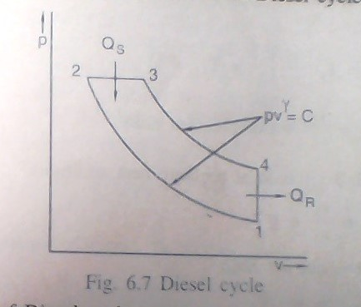
Diesel cycle:

Slide 25
Cont.
Process 1-2:Rrversible adiabatic (isentropic) compression of air. Pressure and temperature of air will increase.
Process 2-3:Heat addition at constant pressure. During this process of air remain constant and volume and temperature will increase.
Volume ratio v3/v2 is called cut-out ratio.
Process 3-4:Reversible adiabatic (isentropic) expansion of air. Pressure and temperature of air will decrease.
Process 4-1:Heat rejection at constant volume, pressure and temperature of air will decrease.

Slide 26
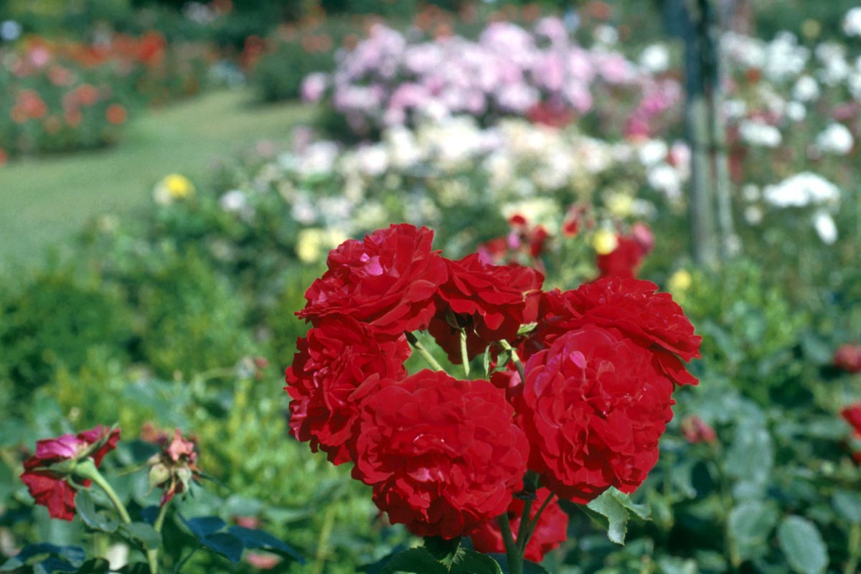
Thank you

